Slide 1
UNIX BASIC COMMANDS

Slide 2
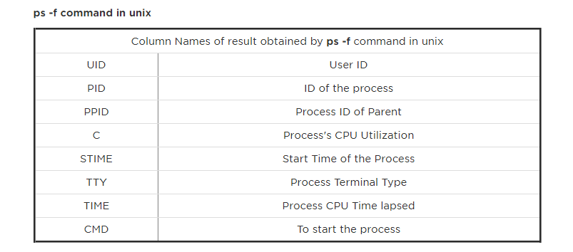
3. How will you find which operating system your system is running on in UNIX?
By using command "uname -a" in UNIX

Slide 3
4. How will you run a process in background? How will you bring that into foreground and how will you kill that process?
For running a process in background use "&" in command line. For bringing it back in foreground use command "fg jobid" and for getting job id you use command jobs, for killing that process find PID and use kill -9 PID command. This is indeed a good Unix Command interview questions because many of programmer not familiar with background process in UNIX.
8. How do you find which process is taking how much CPU?
By using "top" command in UNIX, there could be multiple follow-up UNIX command interview questions based upon response of this because “TOP” command has various interactive options to sort result based upon various parameter.

Slide 4
SCP from local machine to remote server(type on local terminal ) scp (optional –c/-v/-r for compression/progress tracking/To copy dir recursively) filename hostnameofRemoteServer@IPAddressOfRemoteServer(use ipconfigt fnd out ) :/home/training(path of remote mchine whereu want to copy data)
SCP from Remote machine to local machine (type this too on local terminal ) scp (optional –c/-v/-r for compression/progress tracking/To copy dir recursively) filename hostnameofRemoteServer@IPAddressOfRemoteServer(use ipconfigt fnd out ) :/home/training(path of remote mchine from whereu want to send data) pathoflocalmachine

